Slide 1


Group Number 10
Sahil Dhingra: sahdhin@iu.edu
Pragat Wagle: pwagle@iupui.edu
Mark Green: margree@iu.edu
Kunal Singh: singhku@iu.edu
HOME CREDIT DEFAULT RISK PREDICTION

Slide 2
Description of the PROJECT
HOME CREDIT SET UP A COMPETITION ON KAGGLE TO USE MACHINE LEARNING TO Ensure CLIENTS CAPABLE OF LOAN REPAYMENT ARE NOT REJECTed LOANS
THIS PROJECT AIMS TO IMPROVE FINANCIAL INCLUSION BY INCLUDING TELCO AND TRANSACTIONAL DATA TO PREDICT CLIENT REPAYMENT ABLITY

Slide 3
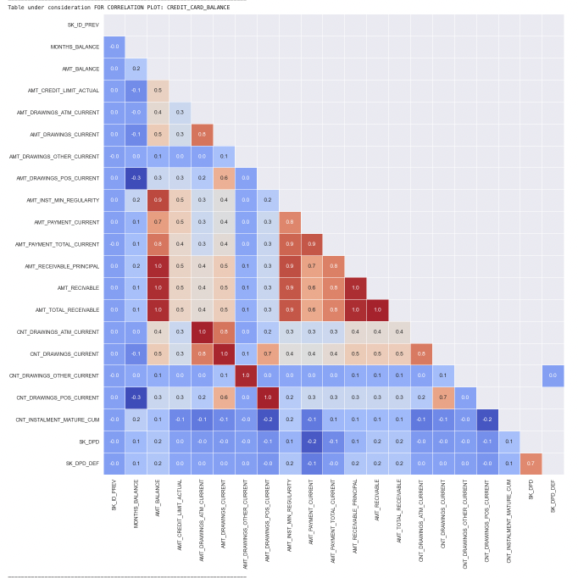
Examples OF VISUAL EDA : A correlation Chart
Below is an example of A correlation CHART for One of the Tables we used Credit Card Balance
Correlation is a statistical measure that expresses the extent to which two variables are linearly related (meaning they change together at a constant rate)
High degree: ± 0.50 and ± 1, strong correlation.
Moderate degree: ± 0.30 and ± 0.49, medium correlation.
Low degree: Below + . 29, small correlation.

Slide 4
Examples OF VISUAL EDA : HistoGram, Boxplot, and Density
Below is an example of Numerical analysis done on the table PREVIOUS_APPLICATION. It consists of a Histogram, BoxPlot, and density
a diagram consisting of rectangles whose area is proportional to the frequency of a variable and whose width is equal to the class interval.
It is often used to illustrate the major features of the distribution of the data in a convenient form.
A boxplot is a standardized way of displaying the distribution of data based on a five number summary
It can tell you about your outliers and what their values are.
A density plot is a representation of the distribution of a numeric variable.
Allows for smoother distributions by smoothing out the noise.

Slide 5
OVERVIEW OF THE MODELING PIPELINES THAT WERE EXPLORED
Below is picture of the Code used for our Pipeline
A Numerical Pipeline was created with imputer, to replace missing values with median and standard Scala to remove the mean and scales each feature/variable to unit variance.
A Categorical PipeLine also consisted of the IMputer and then OHE to to perform “binarization” of the categories to each other and include it as a feature to train the model.
They were both combined into a data pipeline and logistic regression performed using GridSearchCv

Slide 6
Results and Discussion of the Results
To The Right is a picture of the results obtained using The pipelines below exp_name
Initially in phase one before all of our transformations and roll ups we achieved The Scores seen in the figure to there Right
PHASE 1
PHASE 2
To the right is picture of the results obtained using Our Model FROM PHASE 2
EDA improved our accuracy as we rolled up data and aggregated them by ["min", "max", "count", "sum", "median", "mean", “var”]. Also with OHE, Imputer, transformations, removAL of columns if certain ratio of them were null, And Specific Calculations our overall accuracy improved.

Slide 7
Conclusion from Phase 2 and Next Steps
The Majority of phase 2 was dedicated to rolling up the data and EDA by aggregating based off ["min", "max", "count", "sum", "median", "mean", “var”].
Our overall Test accuracy Did not change significantly but the AUC IMPROVED. From Phase 1 the Baseline with 120 features gave 0.7478, 0.7472, 0.7434 for Train AUC, Valid AUC, and Test AUC Respectively. In Phase 2 After Aggregation and further EDA The AUC measures were 0.7724, 0.7585, 0.7623 for Train AUC, Valid AUC, and Test AUC Respectively.
This showed how important it is to roll up and perform EDA and transformations as it has improved the accuracy of the model
With future Feature Engineering we hope to continue to improve the accuracy of the model.

Slide 8
THE FOUR P’s: Past, Present, Next Phase Plan, and Problems
PAST PHASE 1 Tasks
In the previous Phase We have completed Data Descriptions, Evaluation of Algorithm and Metrics, Designing a BaseLine Pipeline to use for Model Evaluation with Logistic Regression, and a Conclusion and Result analysis on our initial data with Minimal transformations and EDA.
PAST PHASE 2 Tasks
Phase 2 Introduced more EDA and Roll up of the Data to Create our Initial transformed Train Data to improve our model. This EDA was performed on all data and experiments were performed on this newly transformed data. The goal was to improve our accuracy and test measures.
NEXT PHASE tasks
The Plan for the next phase is to perform specific features transformations and selective features selections. Our Goals are to Introduce other measures for selection features and introduce more processes to our existing pipelines. Hyper ParameterTuning Tuning
Problems
Size of dataset and Visual Eda
Need to Continue to improve our feature selection process beyond correlation and collinearity.

